Slide 1
OOP Project
Quarto
Students
Hripsime Melikyan
Meri Sukiasyan
Arthur Aghamyan
Instructors
Varduhi Yeghiazaryan
Hovag Abrahamian

Slide 2
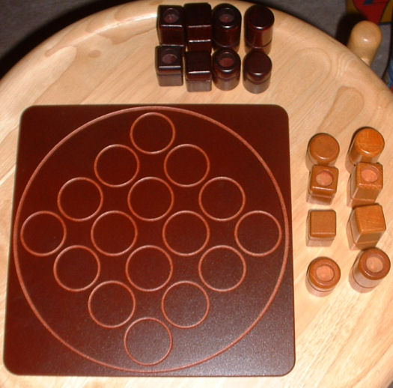
Quarto
Quarto is a board game for two players.
The game is played on a 4×4 board. There are 16 unique pieces to play with, each of which is either:
tall or short;
red or blue (or a different pair of colors, e.g. light- or dark-stained wood);
square or circular; and
hollow-top or solid-top.
Players take turns choosing a piece which the other player must then place on the board. A player wins by placing a piece on the board which forms a horizontal, vertical, or diagonal row of four pieces, all of which have a common attribute.

Slide 3
Classes
Game Package
Console Package
UI Package
Position
Figure
ShortCircular
ShortSquare
TallCircular
TallSquare
AvailableFigures
Quarto
ConsoleQuarto
Players
Quarto UI

Slide 4
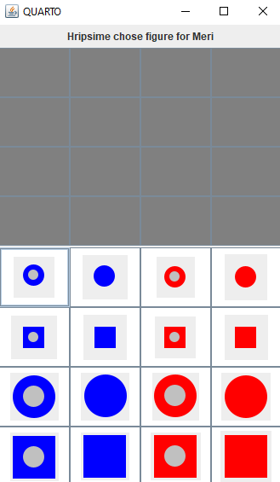
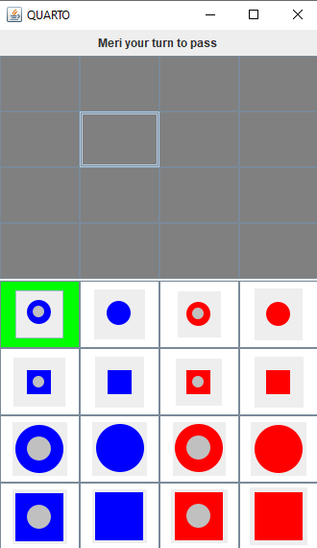
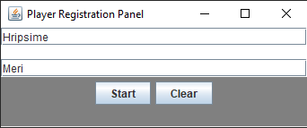
UI Demonstration
First input players name

Slide 5
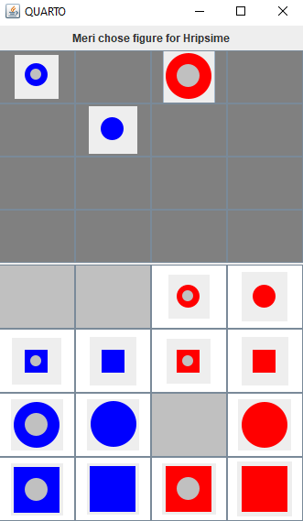
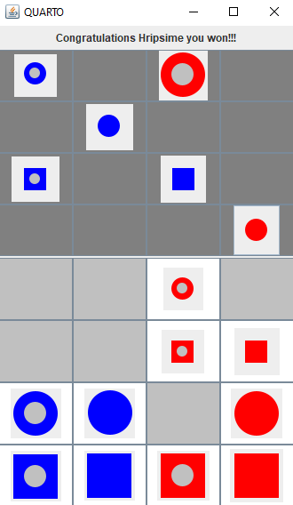

Slide 6
Thank You
Q&A

